Slide 1
Assessment 2. Emerging Response Design Solution
Machine Learning-Based Solution to Combat Plastic and Polythene Pollution: A case Study in the Community of Glenelg, Adelaide, South Australia.
Student name:

Slide 2
ACKNOWLEDGEMENT
I extend my heartfelt gratitude and appreciation to the community of Glenelg, Adelaide, South Australia, for their enthusiastic and unwavering participation in this research endeavor. Their active involvement in interviews and sharing valuable insights has been instrumental in shaping this emerging design solution

Slide 3
Abstract
In Australia, the issue of plastic and polythene pollution is emerging dure to increase in urbanization, population growth, and prevalent use of single-use plastics. Polythene has always been a threat to the environment since its invention. It is non-biodegradable and very difficult to recycle. Even after many awareness campaigns and practices, Separation of polythene bags from waste has been a challenge for human civilization. The primary method of segregation deployed is manual handpicking, which causes a dangerous health hazards to the workers and is also highly inefficient due to human errors. Designing and research response on this using image-based classification of polythene bags using machine learning model can be more efficient efficiency.
My focus is on the architecture and statistical analysis of its performance on the data set as well as problems experienced in the classification. It also suggests a modified loss function to specifically detect polythene irrespective of its individual features. It aims to help the current environment protection endeavors and save countless lives lost to the hazards caused by current methods.

Slide 4
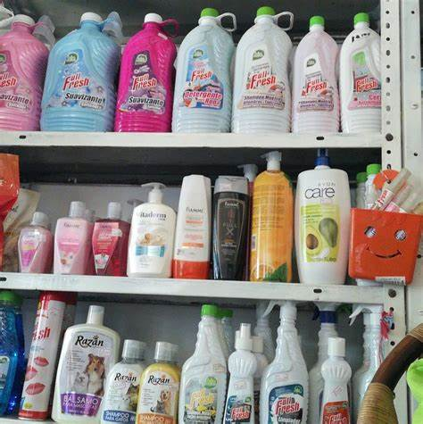
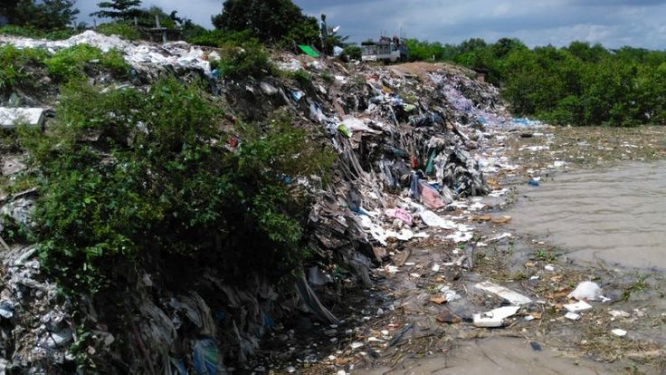
Introduction / Motivation
1
Use of plastics and polythene bags.
2
Analysis of peoples' problems at the ground level.
3
The problem statements are analyzed and determined based on what is in our study area.

Slide 5

Objectives
To design a billboard that is connected to machine learning based cameras that will display polythene prone areas.
1
2
To reduce water and environment pollution by reducing the usage of polythene bags.
Source : Google [21]

Slide 6
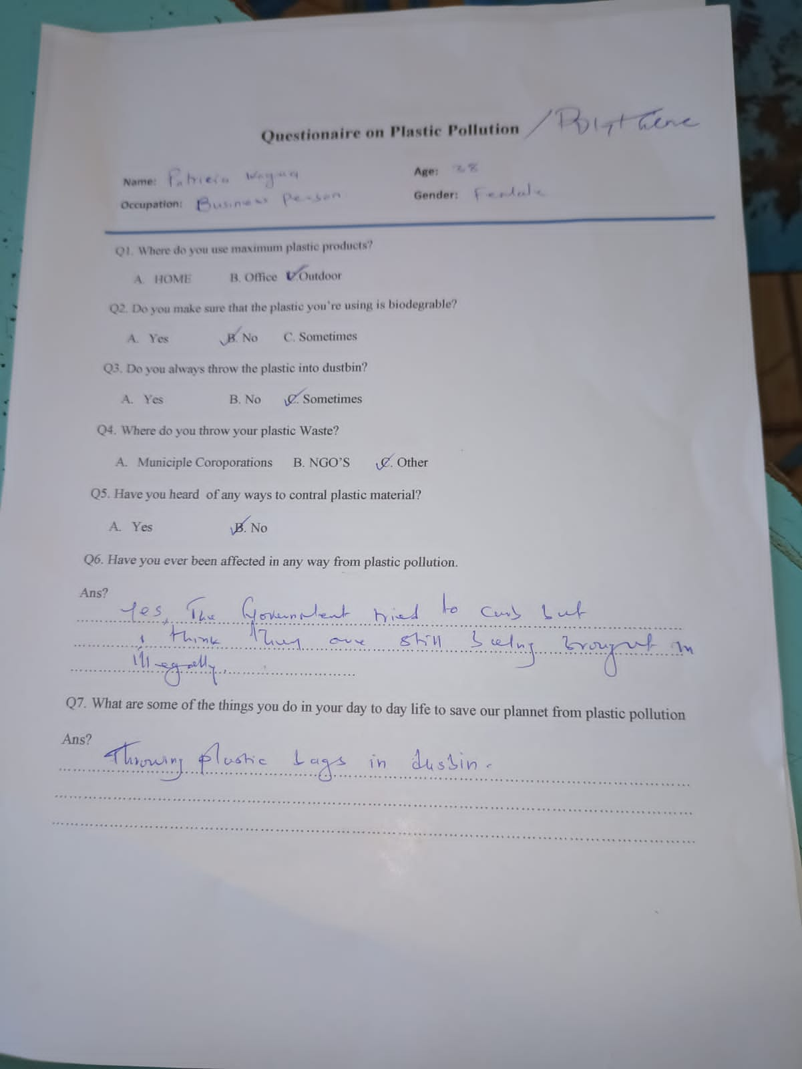
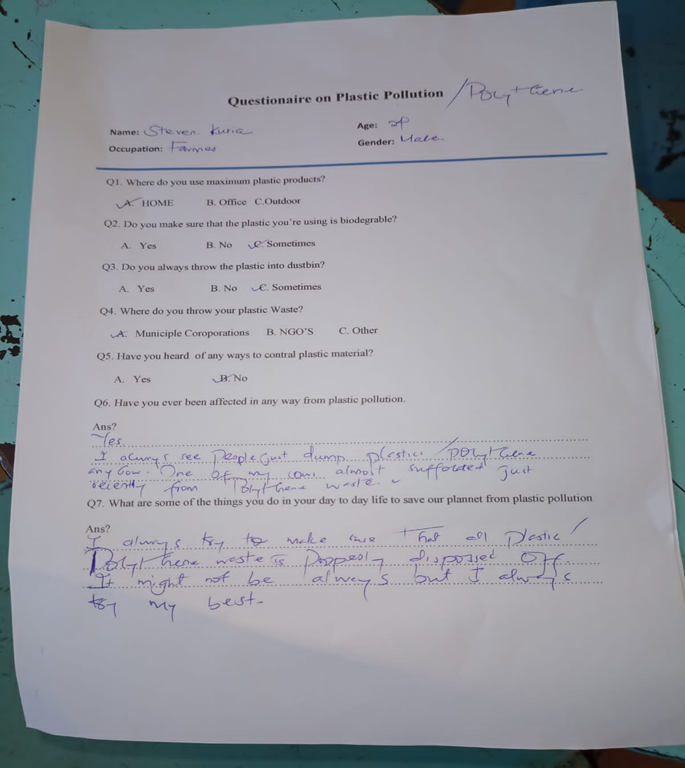
Methodology
Ground Analysis

Slide 7
Themes and headlines generated.
Conservation nightmare as plastic bags creep back.
Environmental activists are worried that plastic bags are slowly creeping back and have been polluting the environment and water bodies thus interfering with vegetation, and human, marine, and aquatic life. This is emerging due to increasing urbanization, population growth, and the prevalent use of single-use plastics. The lack of recycling infrastructure and awareness about plastics environmental impacts contribute to the problem
The community or organizations approach among the communities to embrace government rule of banning plastic bags.
We share a common water source, plastic waste effects drainage and marine life within our rivers and lakes. This issue affects everyone .There should be a community approach among the counties to embrace government rule of banning plastic bags. To ensure that all countries partake in and enforce the law.
Communities and Industries opposing the banning of plastic bags.
Most plastic bags end up in landfills or as litter and no matter how you tabulate the numbers, plastic bags do not safely break down and it costs money to pick up litter. People and groups against banning plastic bags attempt to diminish the harmful and damaging realities of these facts.

Slide 8
The HMW questions generated
How might we encourage people to stop using plastic bags?
How might we use technology in reducing plastic pollution?
How might we make the community around us aware of the importance of reducing the consumption of plastic?

Slide 9
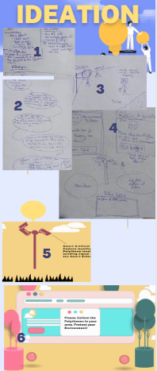
Brainstorming ideas generated
The promising idea
Designing an electronic billboard that will be installed around the city's streets and include a monitoring system become our major idea. The green indicator for a clean street and a red-light alert icon whenever there is plastic nearby, the automated display will indicate, "Please, there is plastic about; gather it and discard it in the nearest bin." And “thank you for maintaining the place clean” a green indicator for a safe and clean environment. The inhabitants in the area will be disturbed by the policies' existence, and this approach will increase awareness of the importance of maintaining a clean environment.
Why this option is better is because;
•It is my original idea and it has never been applied before by anybody
•The displays create awareness among the public on environmental conservation

Slide 10
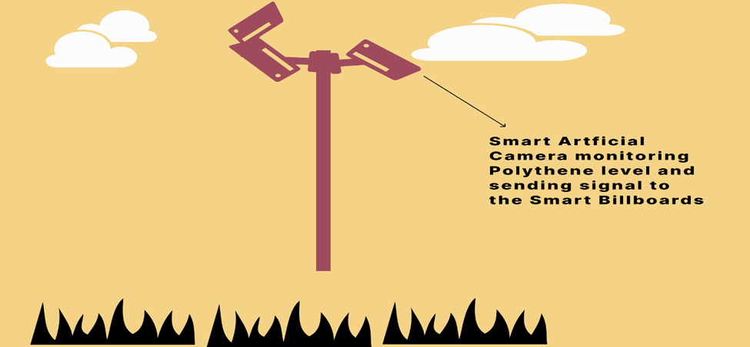
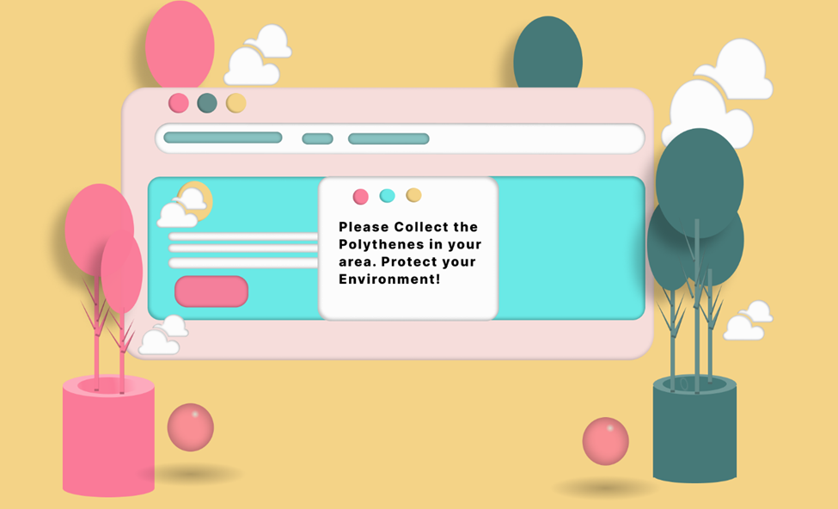
Prototyping
An electronic billboard that will be installed around the city's streets, markets, public squares, and any place that is prone to polythene use and damping.
This system includes a surveillance camera mounted on big poles or towers around places 360 degrees view to capture the whole area radius.
The monitoring will include a machine learning-trained model, which will be able to identify the presence of polythene material in the surrounding, if polythene is spotted nearby, the monitoring system is able to detect it and send signals to the closer display system with notice of plastic around.
For displaying we have used 3 color demonstrations,
1.Green, -green, is normally perceived by nature as a cool peaceful, and serene environment
We have used green color to demonstrate the kind of secure environment we have. This color will come with thank you message “thank you for keeping the environment clean.
2. Yellow – yellow color represent moderates of the environment cleanness.
3.Red – red color portends danger, insecurity, or war. We have used red to describe how pathetic and insecure the environment is, red color will be displayed with “please look around, there is polythene around make the environment clean.

Slide 11
Feedback
Our main goal in going back to the field was to receive the users’ feedback. We did some interviews with the users and collected their perspectives about the designed prototype of the smart billboard and how it’s supposed to function, which was actually aimed at measuring the usability of the smart billboard application in terms of the criteria of efficiency, effectiveness, learnability, control, and helpfulness.
The evaluation provided useful explanations for some of the findings but overall the findings confirmed the importance of smart billboards in various areas as the users provided us with lots of insights on the reporting formats such as providing the data dimensions completely and consistently being displayed on the billboard, Up-to-date data about the areas that are not taking measures about polythene as placed by the government.

Slide 12
Table of Feedback:
Effectiveness | Users suggested that the information should be displayed in an uncluttered and well-structured manner so that it can attract their attention. Instructions should be visible and self-explanatory about the polythene prone areas so that they can take measures. The smart billboard should communicate the adherence status at all times. The smart billboard should be able also to detect the plastic bag packaging seals that are used in supermarkets if possible,
Learnability | The application should limit the memory load for example if it’s being fed with huge amount of image data from various locations. The application should promote learnability to make it accessible for infrequent usage of all the people using the billboard. The terminology used should be familiar to the users in the community.
Utility | The system should display a hierarchical map to determine data granularity level. Reporting formats should include the relevant data dimensions about the polythene bags. The data should be up-to-date or else users should be notified that the data is outdated. The smart billboard should allow knowledge sharing and exporting data. There should be information visualization functionality (comparison charts, graphs to reveal trends, etc.) to assist in decision making in those specific areas. The application should provide a rapid response rate in case of polythene detection. The application behavior should be consistent always at any given time
Effectiveness | The collection and sorting of the images by the smart billboard need to be able to effectively segregate degradable plastic bags from non-degradable bags, and use corresponding processing and recycling technologies for effective treatment.

Slide 13
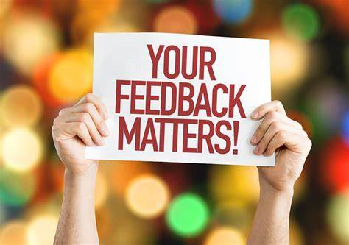

Comments from users
User1:
“Good idea when implemented, it will not only help preserve our environment but also create social awareness of environmental cleanliness, not only from the polythene perspective but in general. "People will become aware that whenever they are done using something, they aren’t just supposed to dispose of it anyhow but dispose of it in an appropriate place, and anybody who will be found disposing of litter on the roadside must be held responsible. This will also give a sense of the present policy on polythene and waste management; hence, the community will be abiding by it out of a sense of fear that you are being watched by someone behind the cameras somewhere.”
User2:
“Good idea, but we will live in fear of being monitored."
User3:
"Our government should do such a thing." I would like to stay in a clean environment and use biodegradable material, but sometimes we are forced to use the available polythene bags because we don’t have an alternative. "If this is implemented, then it will save our environment."

Slide 14

Conclusion
Taking care of our environment is worth spending time and resources; we don’t have a plan B earth to spend the rest of our lives or for our generations to come; if we live on destroying our nature and environment; some day we’ll have nothing left to call home in the earth. The use of polythene is overwhelming though measure have been put in place to control the use, these material finds themselves in our environment and there is no way we can blame the users for that; users are not the enemy, its either lack enough measures to stop or control the use. To try solve, and protect our nature We have developed and designed system bearing the user in mind that will help reduce pollution in our environment.

Slide 15
THANK YOU

